Slide 1

Introduction to CodeIgniter
Refresh Cambridge, October 3rd 2007

Slide 2
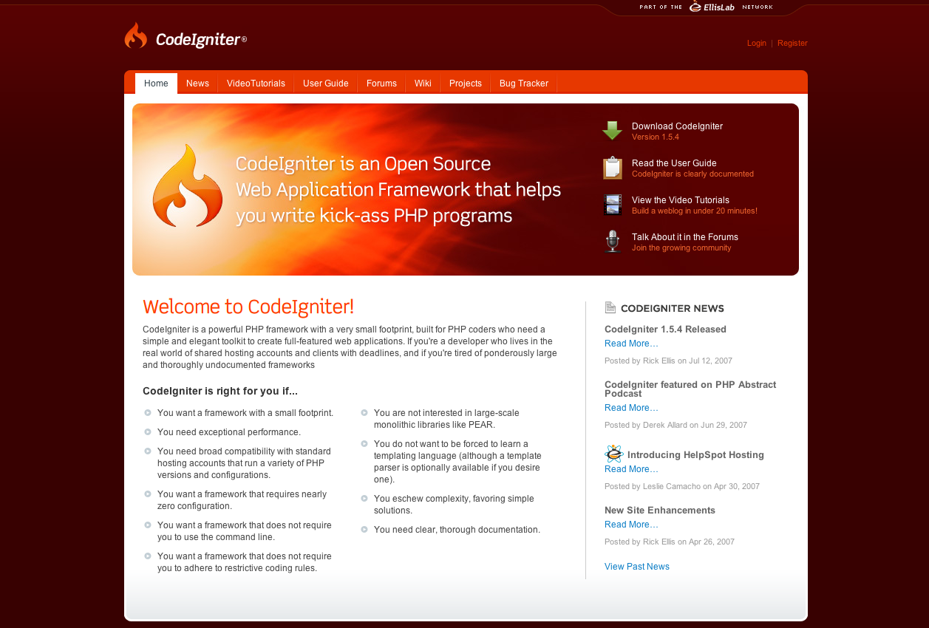

Slide 3
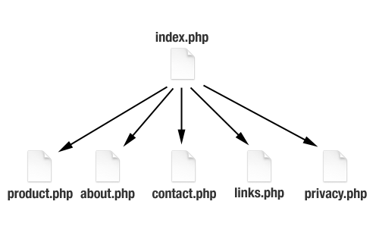
How you first started building websites?

Slide 4
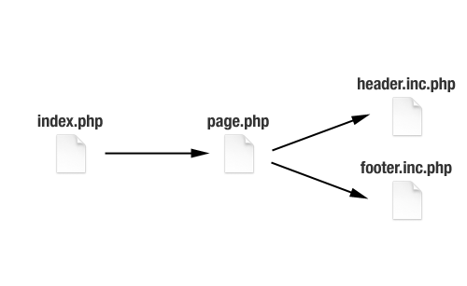
How you’re building websites now?

Slide 5
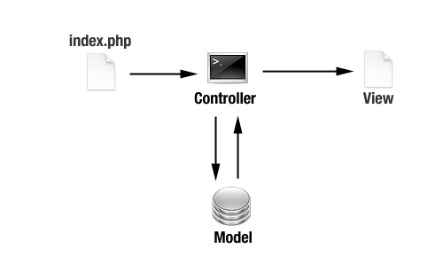
How you build websites with a framework

Slide 6
PHP Frameworks
Codify your application structure
Provide solutions to common problems
Abstract levels of functionality
Make rapid development easier

Slide 7




How do I choose the right framework?
Made by the people who make PHP!
Fastest
Lots of features
PHP5 only
Complex
In beta
Most features
Slowest
Modularised
PHP5 only
Closest to Ruby on Rails
Very active community
Large codebase of plugins and components – Ajax, Auth, etc.
Made by ExpressionEngine
Doesn’t enforce strong MVC patterns
Easier to learn
Very fast
Others: Seagull, WACT, Prado, TRAX, ZooP, eZ Components
http://www.phpit.net/article/ten-different-php-frameworks/

Slide 8
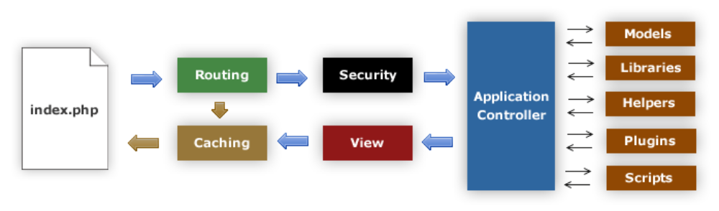
CodeIgniter Process Flow

Slide 9
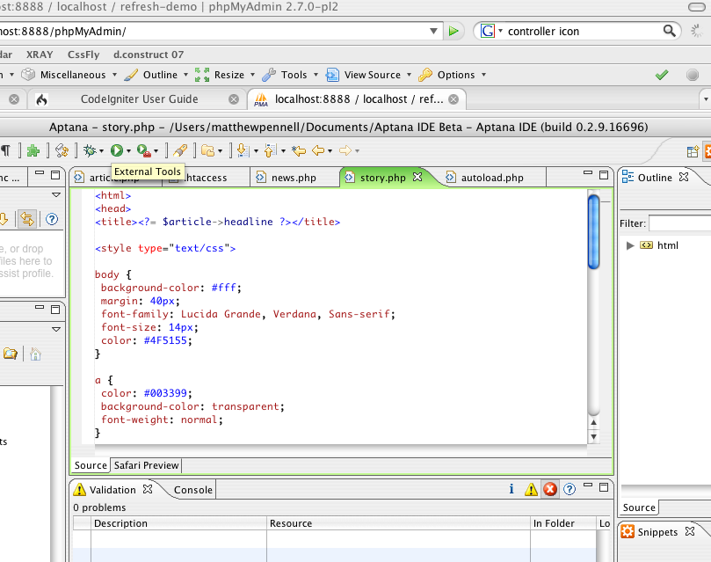
Demonstration!

Slide 10
Classes
Benchmarking Calendaring
Database Email
Encryption File Uploading
FTP HTML Table
Image Manipulation Input and Security
Pagination Session
Trackback Template Parser
Unit Testing URI
User Agent Validation

Slide 11
Helpers
Array Cookie
Date Download
File Form
HTML Security
Smiley String
Text Typography
URL XML

Slide 12
Plugins and Extensions
You can create your own Plugins
You can extend the core Classes to add your own functionality

Slide 13
Support and Community
Most clearly documented User Guide of any framework
Wiki with content contributed by the development community
Active community forums, moderated by staff

Slide 14
Any questions?

